Slide 1
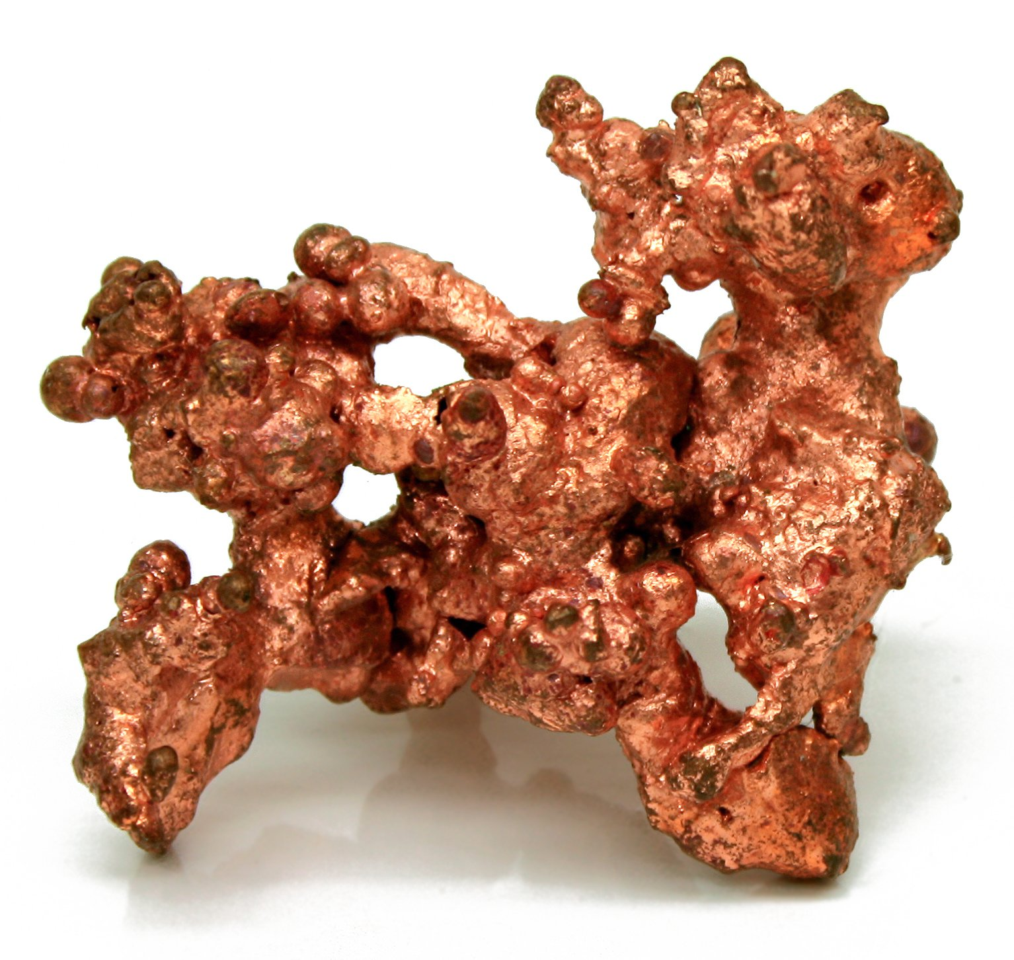
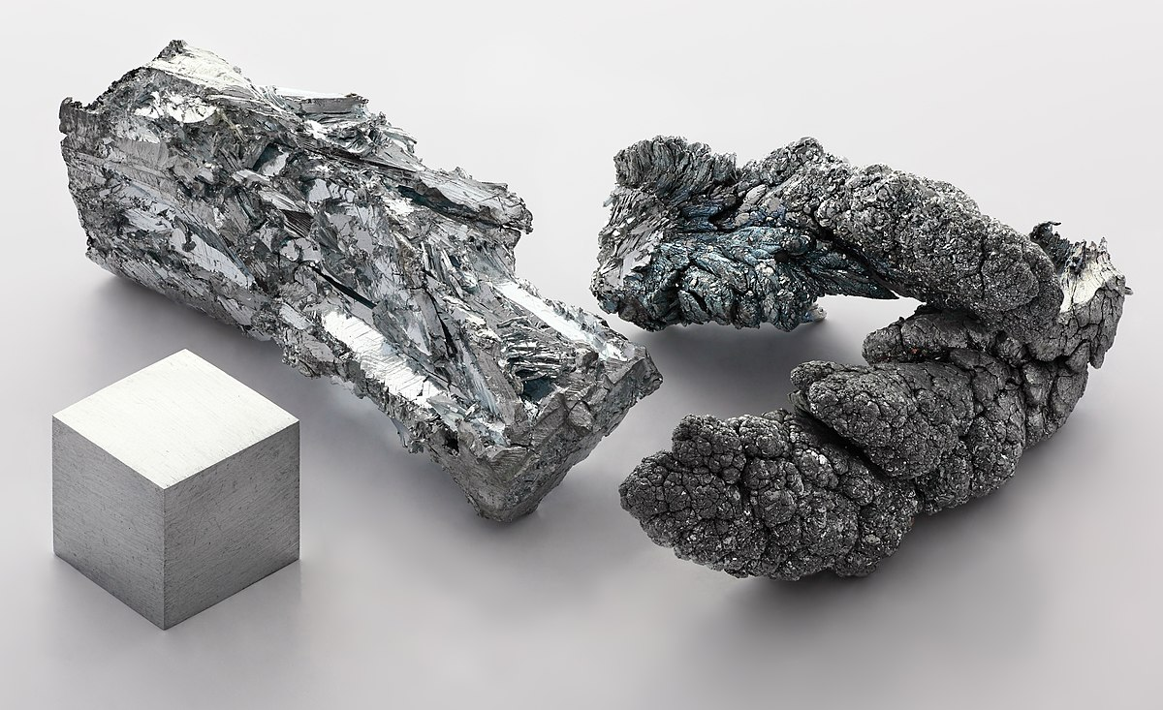
Wyo Well Project
Kurnalpi Western Australia
This Photo by Unknown Author is licensed under CC BY-SA
This Photo by Unknown Author is licensed under CC BY-SA

Slide 2
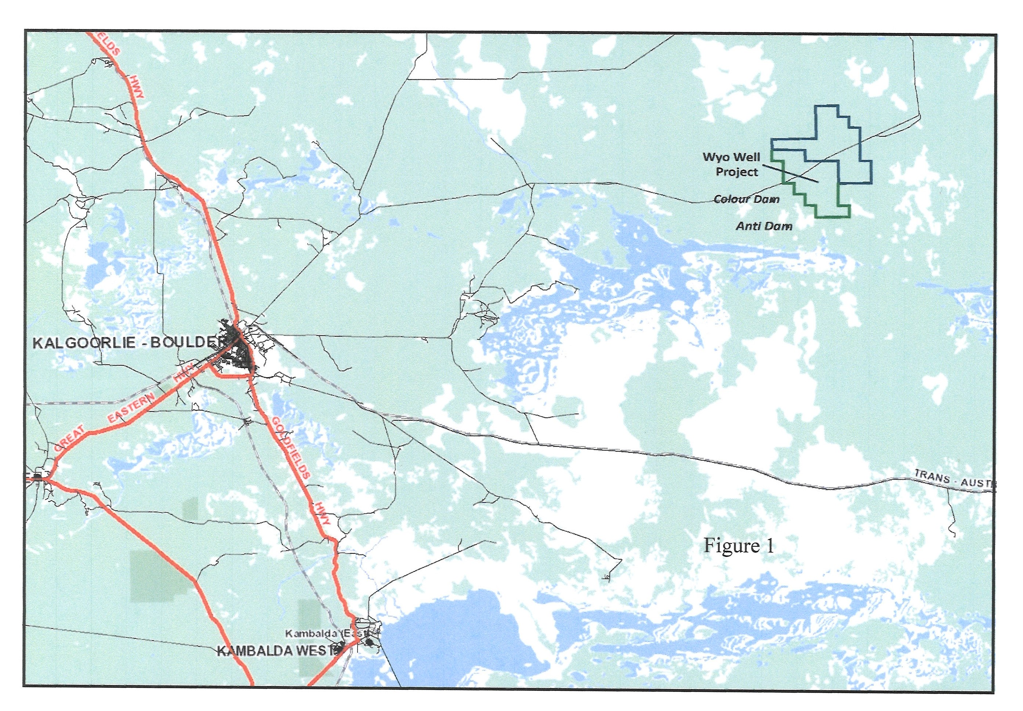
Wyo Well Project Kurnalpi WA
Wyo Well occurs on the eastern margin of the Eastern Goldfields Province of the Kurnalpi terrane of the Yilgarn Craton.
The Geodynamic setting has been interpreted as having a volcanic arc association.
Exploration for VMS deposits has occurred in 2 nearby areas Colour Dam and Anti Dam.
Notes:
In this well known mineralised district of Kurnalpi, Wyo Well occurs on the eastern margin of the Eastern Goldfields Province of the Kurnalpi terrane in contact with a granite batholith in an eastern sector of the Yilgarn Craton. The geodynamic setting of this sector has been interpreted to have a volcanic arc association and from available data it would appear that exploration for volcanogenic massive sulphides (VMS Deposits) has only occurred in 2 nearby areas, Colour Dam 7kms WSW of Wyo Well and Anti Dam 8kms SSW of Wyo Well (Refer: Figure 1) with a view that volcanogenic massive sulphide base metal deposits are present.

Slide 3
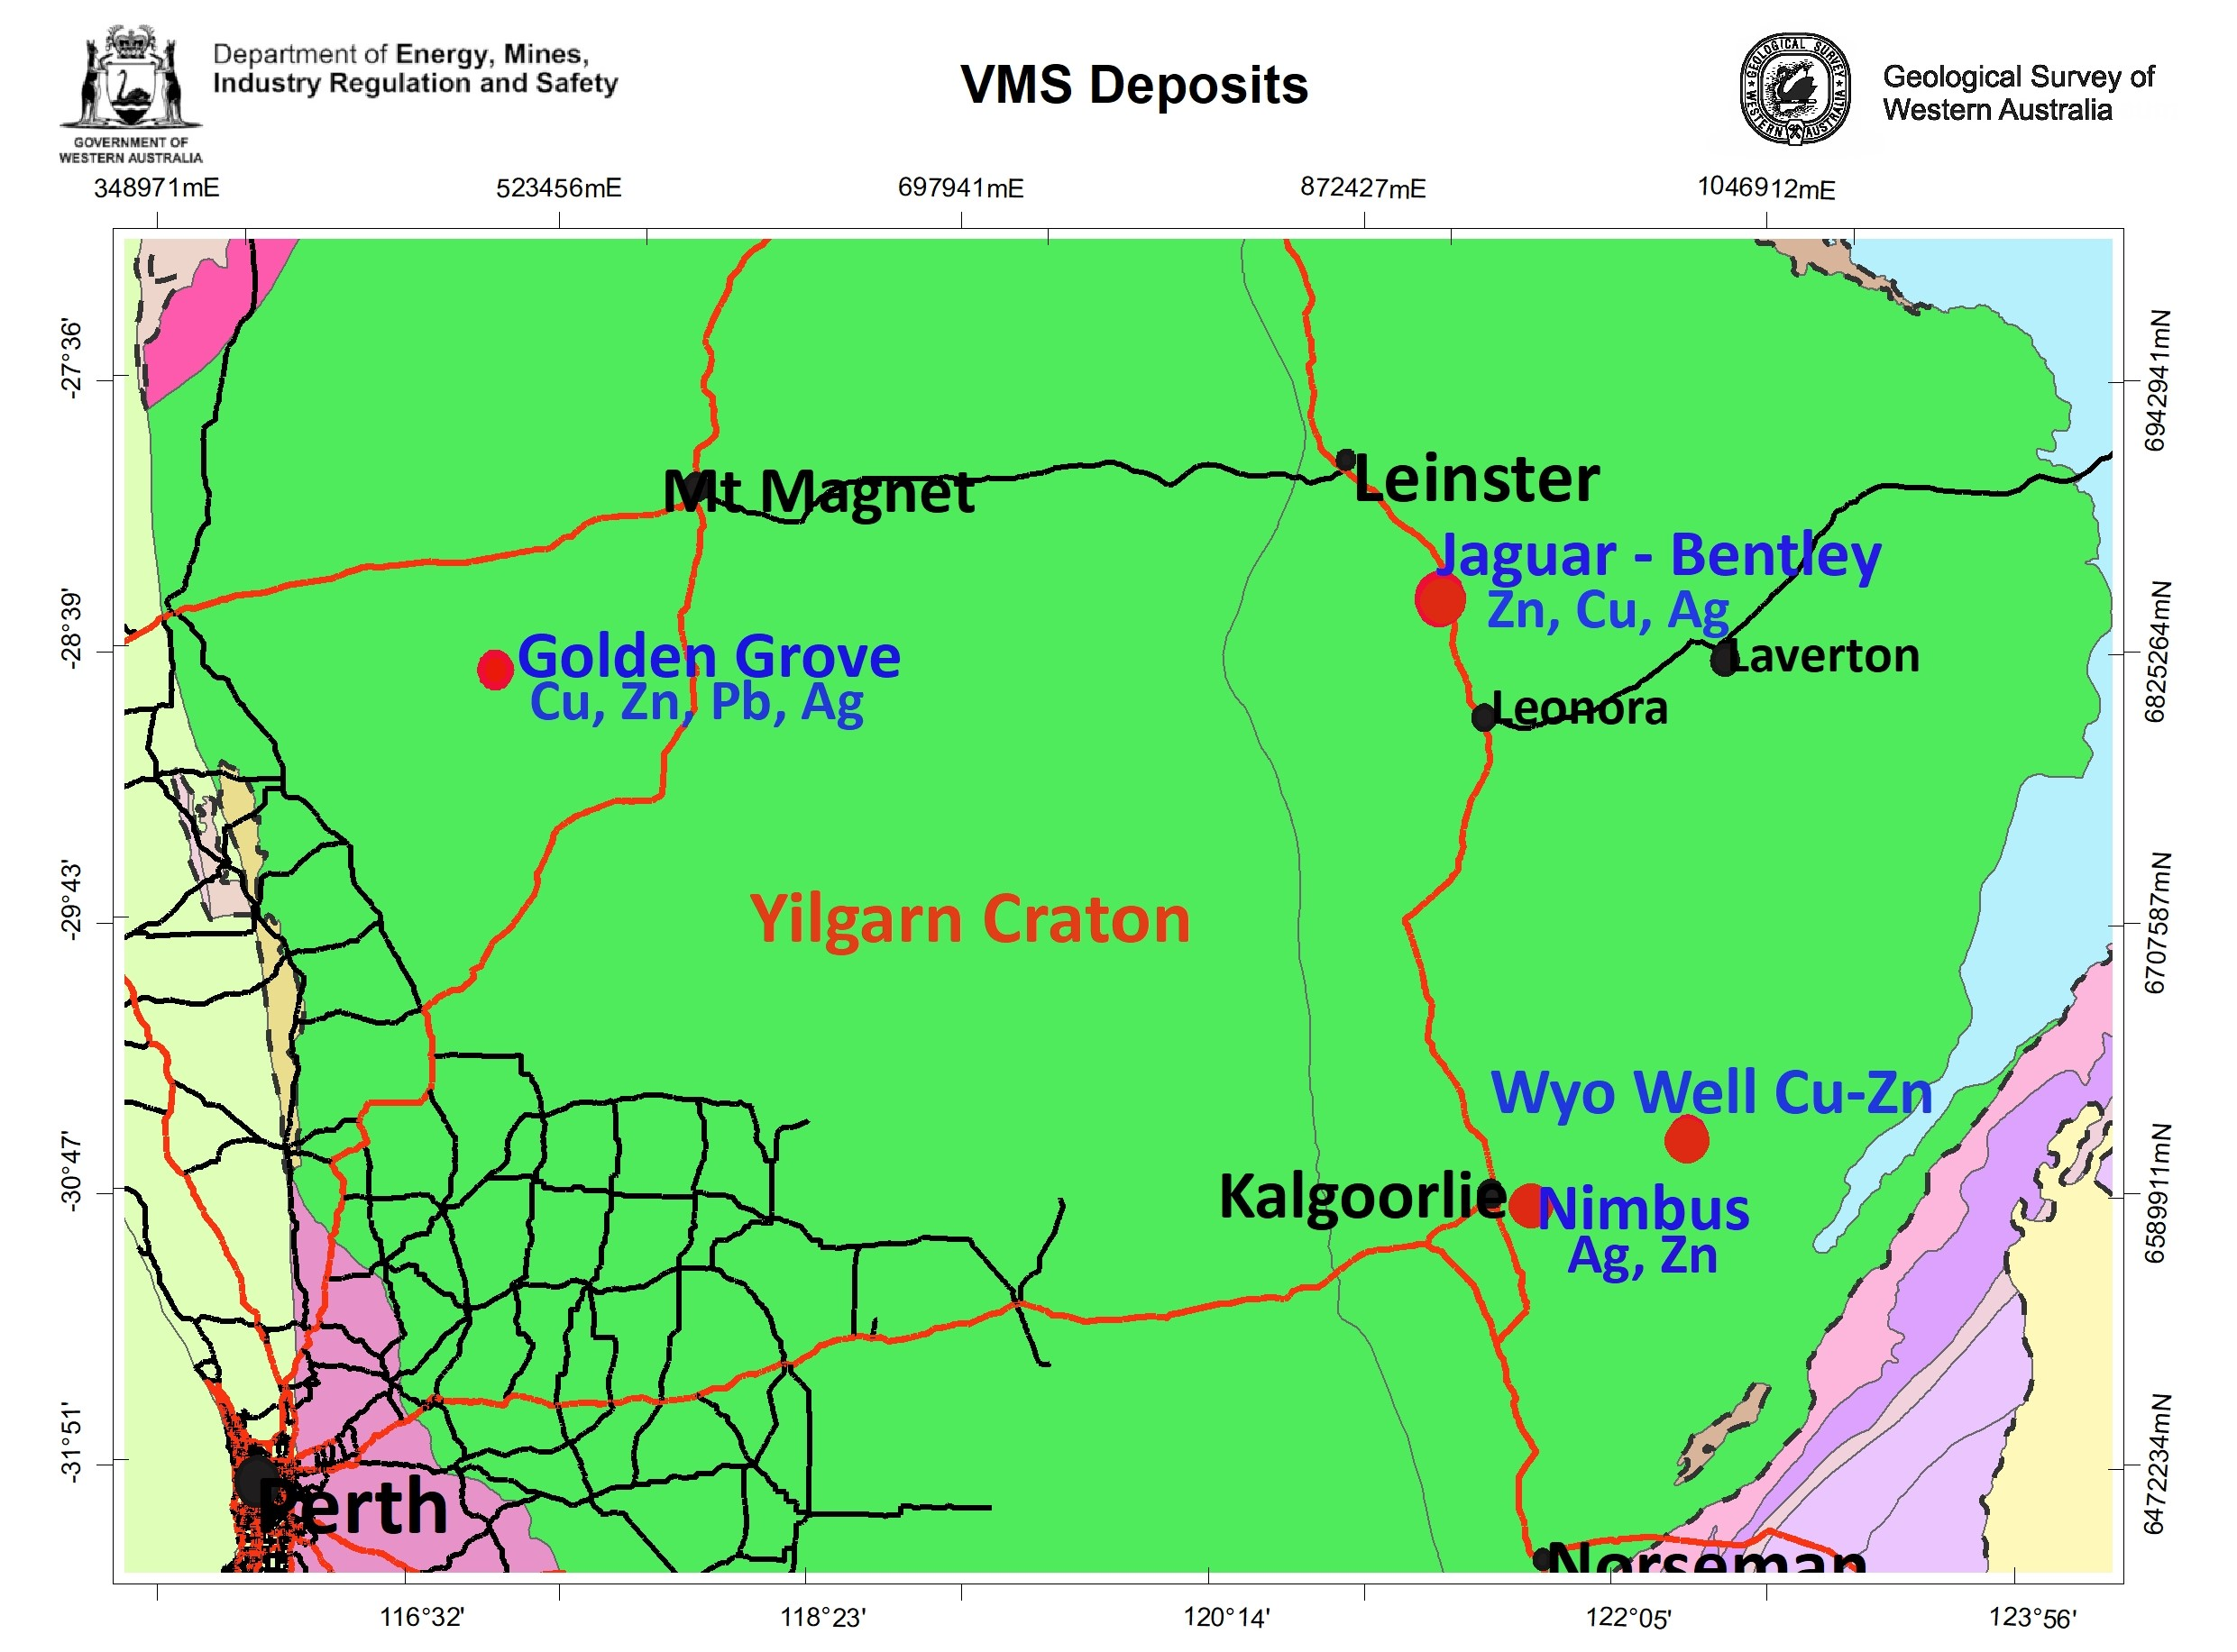
Wyo Well Project Kurnalpi WA
Several VMS deposits occur in the Yilgarn the most prominent being the Jaguar – Bently deposit, the Golden Grove deposit and the Nimbus deposit which is south east of Wyo Well.
Geological characteristics making Wyo Well prospective for Yilgarn VMS deposits include:
Area lies in the Kurnalpi – Palaeo-rift zone near marginal faults.
Host rocks include basalt and mafic derived sedimentary rocks including carbonaceous shales.
Significant zinc mineralisation has been intersected in drill holes.
Notes:
Several VMS deposits are located in the Yilgarn Craton the most prominent being the Jaguar - Teutonic Bore - Bentley deposits north of Leonora and the Nimbus Deposit east of Kalgoorlie occurring in the Gindalbie Domain , a division of the Kurnalpi Terrane interpreted as part of the Kurnalpi Palaeo-rift zone. The Wyo Well prospect sits in the Menangina Domain within a general trend of VMS deposits. Geological characteristics of the Wyo Well Project that are prospective for Yilgarn VMS deposits include:
The area lies in the Kurnalpi Palaeo - rift zone and near the marginal faults of the rift zone.
The Wyo Well host rocks include basalt and mafic derived sedimentary rocks including carbonaceous shales.
Drill core shows felsic-derived sedimentary rocks including a level of bimodal volcanism.
Significant zinc mineralisation has been intersected in all drill holes.
Figure 2
Textural evidence from diamond hole WWD01 indicates the EM Anomaly C1 is part of a VMS System with black shale and cherts locally brecciated with pyrrhotite-pyrite and hydrothermal magnetite occurring as bands within the carbonaceous shale (XirLatem – R. Gordon 2023).

Slide 4
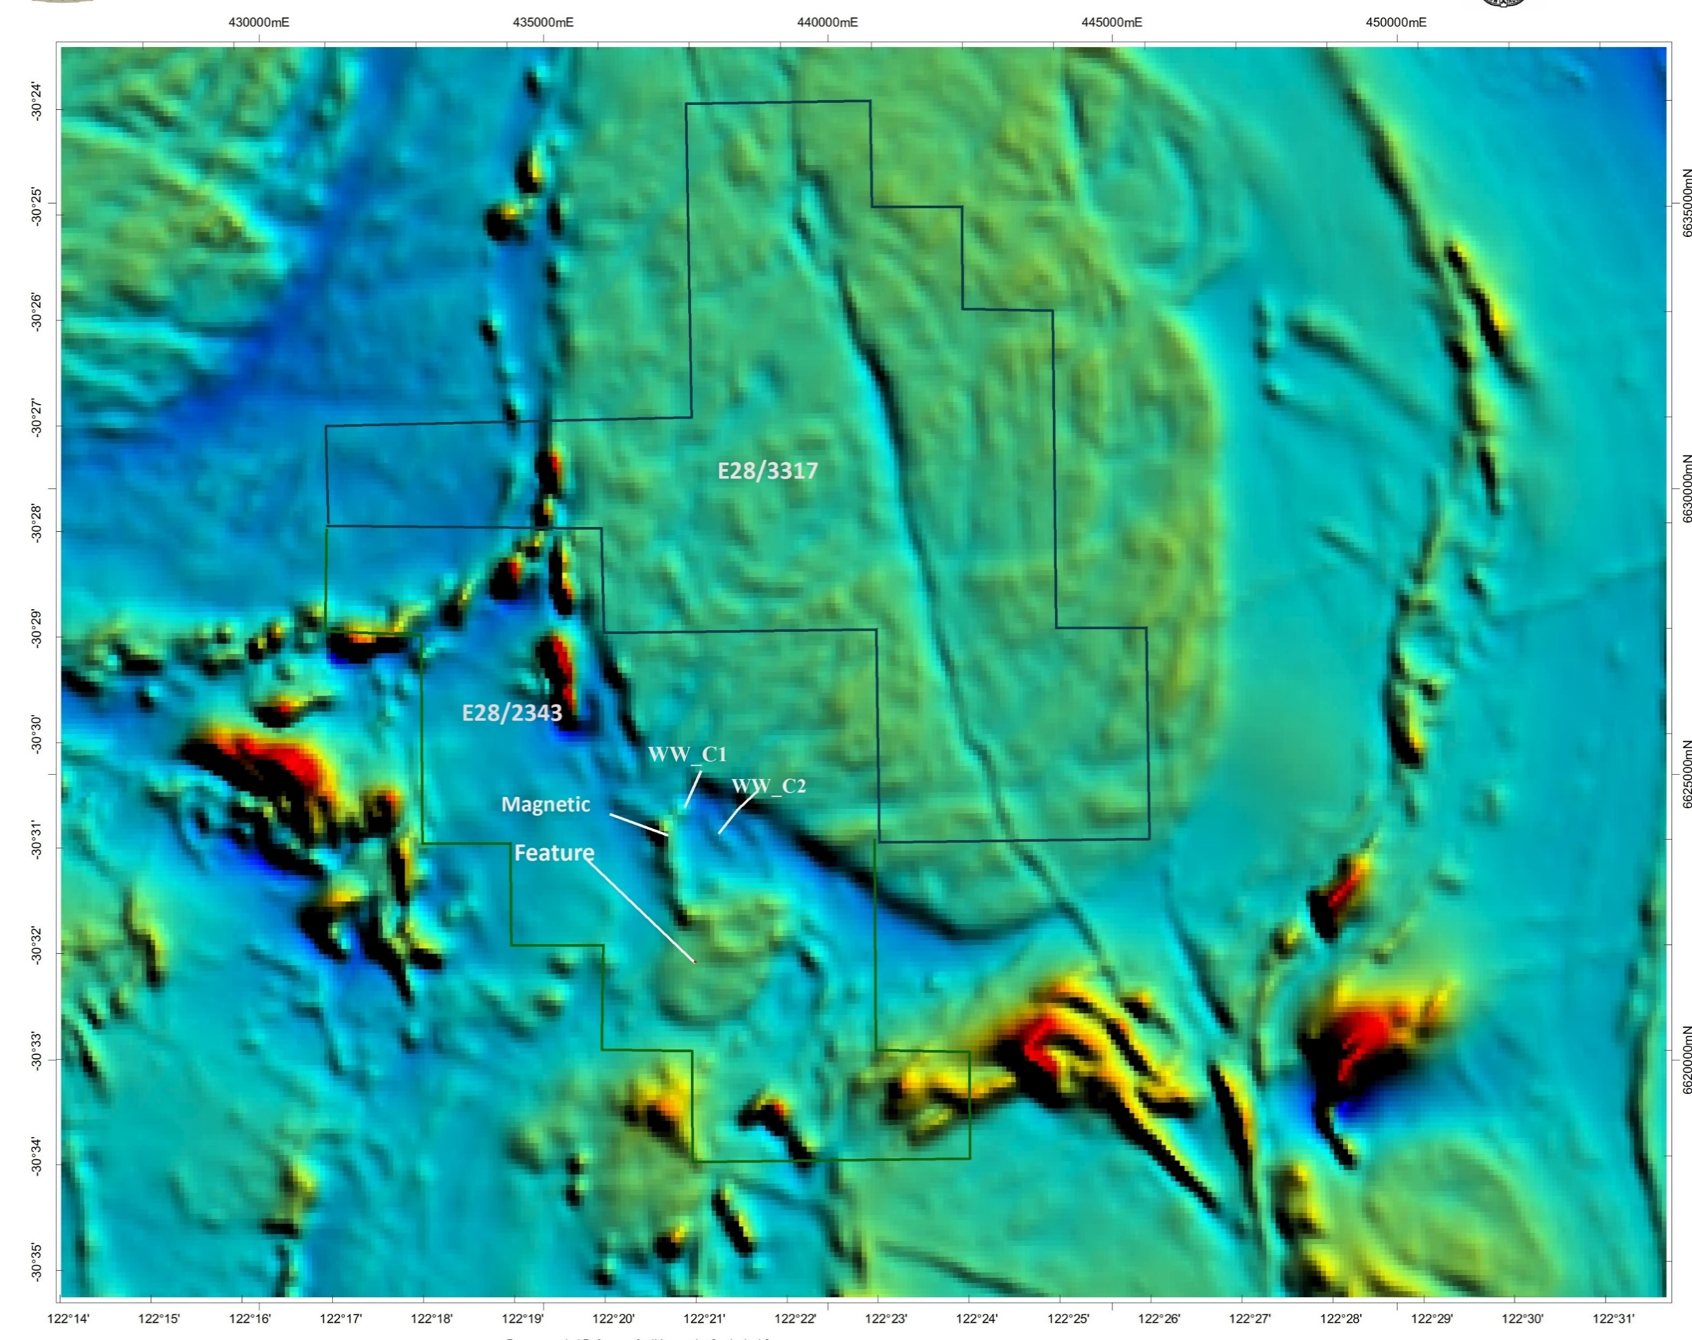
Wyo Well Project Kurnalpi WA
Geology includes units of strongly foliated shales, mafic sediments, basalts and laminated quartz veins having a garnet association indicating deep mineralisation and there is a deep magnetic feature.
A significant circular magnetic feature south of Wyo Well may connect the prospect area by a pipeline structure or volcanic vent.
Previous exploration of the circular feature reported the geology as arenites and tuffaceous material suggesting a volcanic arc association.
Figure 2
Notes:
The geology of the zinc anomalous prospect area near Wyo Well on E28/2343 includes a complex unit of strongly foliated siltstones, carbonaceous shales and laminated quartz veining. The meta-sedimentary sequence is unique in having a garnet association indicating a high temperature and deep origin. The sedimentary unit with associated structural complexity and quartz veining is anomalous in zinc and gold mineralisation. The mafic units include mafic amphibolites, basalts and high magnesium basalts which appear to occur in contact with the anomalous sedimentary units and a granite batholith. South of Wyo Well a significant circular magnetic feature has been interpreted as a pipe like structure (Refer: Figure 2) or could be a volcanic vent which is connected to the prospect area. Previous widely spaced RC drilling of the magnetic image has ruled out the presence of a diamond mineralised kimberlite however the reported geology indicates the presence of arenites and tuffaceous material suggests that there was a volcanic arc association.

Slide 5
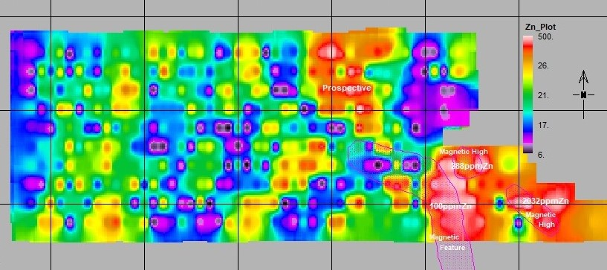
Wyo Well Project Kurnalpi WA
In 2007 an auger soil sampling programme over 12 sq kilometres in a 200m x 100m grid spacings.
A peak result of 2023ppmZn,281ppmCu, 25ppmPb was encounterted and another 11 results greater than 100ppmZn making the SE of the sampled area strongly anomalous for Cu-Pb-Zn mineralisation.
200m X 100m Spacings
2032ppmZn

Slide 6
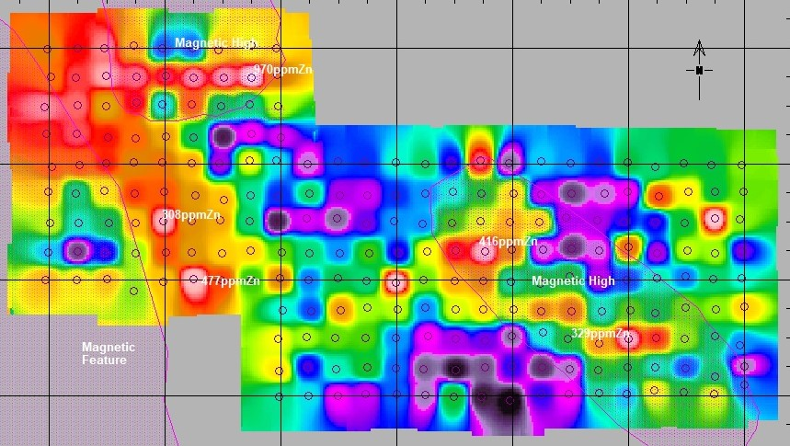
Wyo Well Project Kurnalpi WA
The infill soil programme in a 50m x50m spaced grid pattern with 53 samples above 100ppmZn.
Peak soil result in this SE area was 970ppmZn, with 20 results above 200ppmZn.
Rock chip sampling and geological mapping carried out on the metasediment described as a siltstone in a mafic amphibolite granite area.
Of significance at the time was a small ferruginous gossanous half circular outcrop with a peak assay of 0.3%Zn.

Slide 7
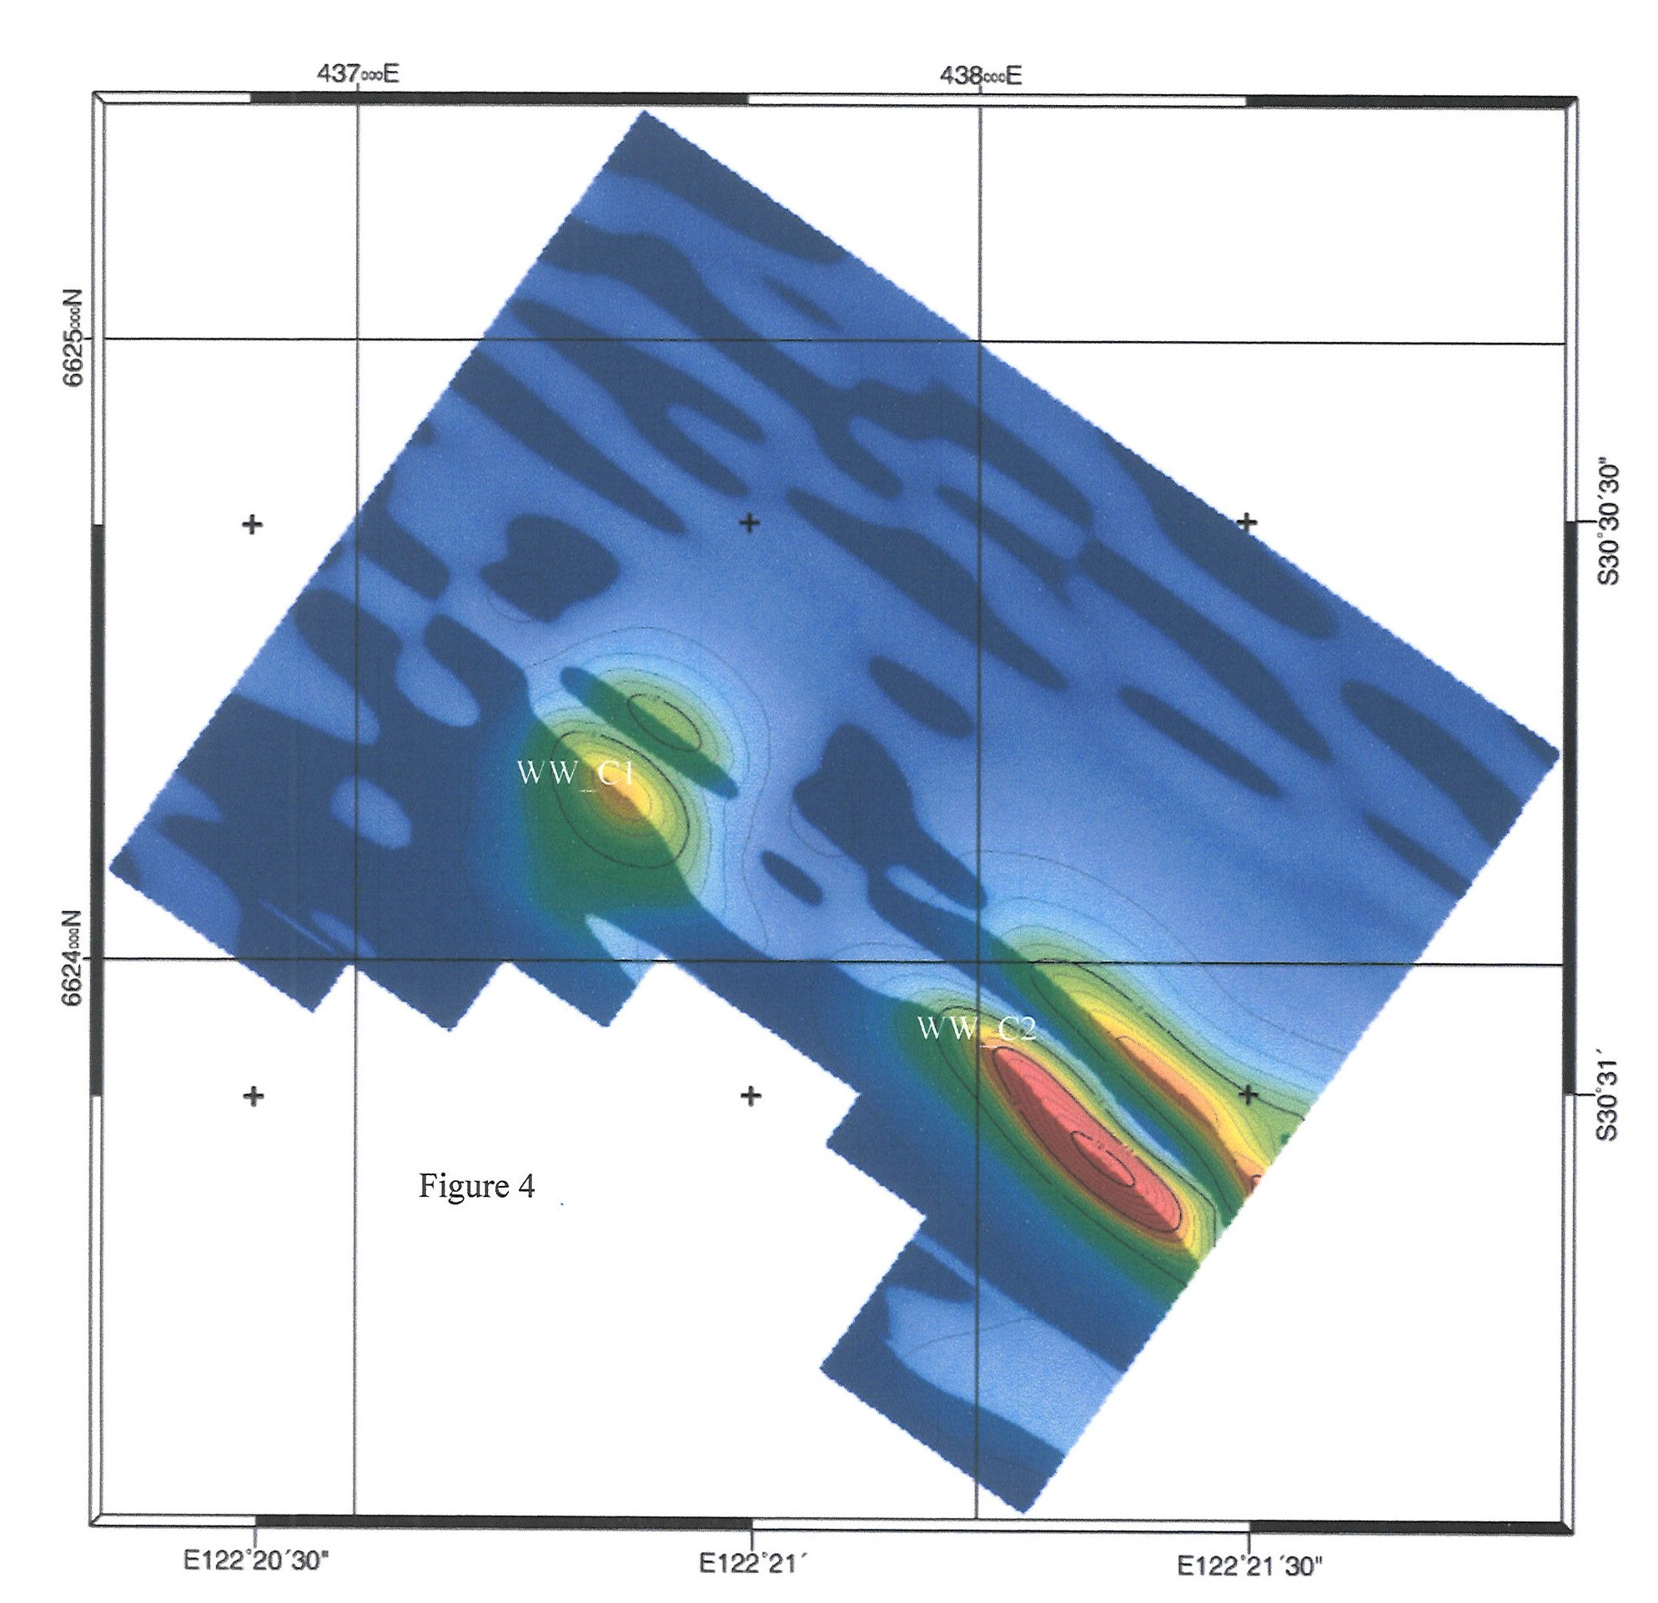
Wyo Well Project Kurnalpi WA
Drilling in 2008 to depths of 60m (WYRC01 – WYRC05) included zones of anomalous Cu-Zn mineralisation with a peak result of 0.3%Zn 2g/tAu.
Two EM anomalies were produced from a MLEM survey in 2011 WW_C1 & WW_C2
Notes:
Drilling in 2008 (WYRC001 – WYRC005) intersected the a siltstone/shale unit at 100m spacings to a depth of 60m. Results from the drilling were anomalous with a peak result of 3000ppmZn and 2g/tAu encouraging further work which subsequently included a MLEM survey in 2011 producing two EM anomalies WW_C1 & WW_C2 (Refer: Figures 4 & 5).

Slide 8
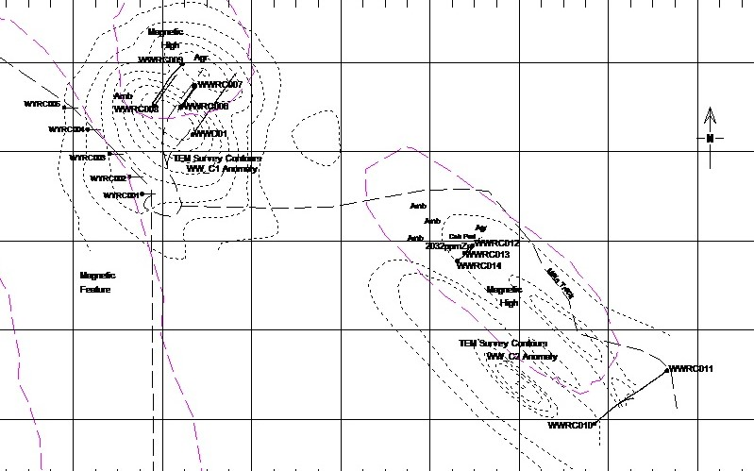
Wyo Well Project Kurnalpi WA
RC drill holes WWRC006 –WWRC014 have been drilled during the period 2019 to 2023
WWRC006 was drilled to intersect the WW_C1 EM anomaly at shallow depth. 4m assay results from 72m to 114m (eoh) ranged from 0.32%Zn 587ppmCu to 0.925%Zn 1140ppmCu.
Elevated values in 4m samples from 84m to 108m averaged 0.65%Zn 1102Cu.
Results from 1m split samples >1%Zn occurred in five 1m intervals between 85 – 104m with a peak result of 1.42%Zn 0.14%Cu.
Notes:
In 2019 a RC hole WWRC006 was drilled to intersect the WW_C1 anomaly at a shallow depth of 74 metres with a total depth for the hole being 114 metres. Assay values for 4m intervals and 1 metre intervals were anomalous being above 0.36%Zn. The four metre assays results from 72m to the end of hole ranged from
Figure 4
36%Zn to 0.925%Zn including elevated values from 84m to 108m of 0.545%Zn to the peak value of 0.925%Zn. Assay results from the one metre split samples included greater than 1%Zn values at 85m, 92m, 94m, 96m and 104m with a peak result of 1.42%Zn (Refer: Figure 6).

Slide 9
Wyo Well Project Kurnalpi WA
Diamond Hole WWD01 designed from downhole EM in WWRC006 to intersect a shallow flat lying conductor and deeper subvertical conductor (Modelling by Southern Geoscience Consultants).
Geology was reflected in WWRC006 with mafic and sedimentary amphibolite in contact with graphitic carbonaceous shale.
Assay results indicated anomalous Cu-Zn mineralisation in contact zones and within the shale units from a depth of 152.75m.
Main intersection from 152.75m averaged 10.23m @ 0.43%Zn 735ppmCu.
Notes:
In 2020 a diamond hole WWD01 was completed using the location and orientation parameters designed to intersect the centre of a shallow flat lying conductor and a deeper subvertical conductor at a depth of approximately 175m, the hole being drilled to a depth of 300.8m. The geology of the diamond hole WWD01 in core reflected the overall geology in WWRC006, a mafic amphibolite in contact with a graphitic carbonaceous shale. Assay results indicated that anomalous zones of zinc mineralisation occurred on contact zones and within carbonaceous shale units of the meta-sedimentary sequence from a down hole depth of 152.75m to

Slide 10
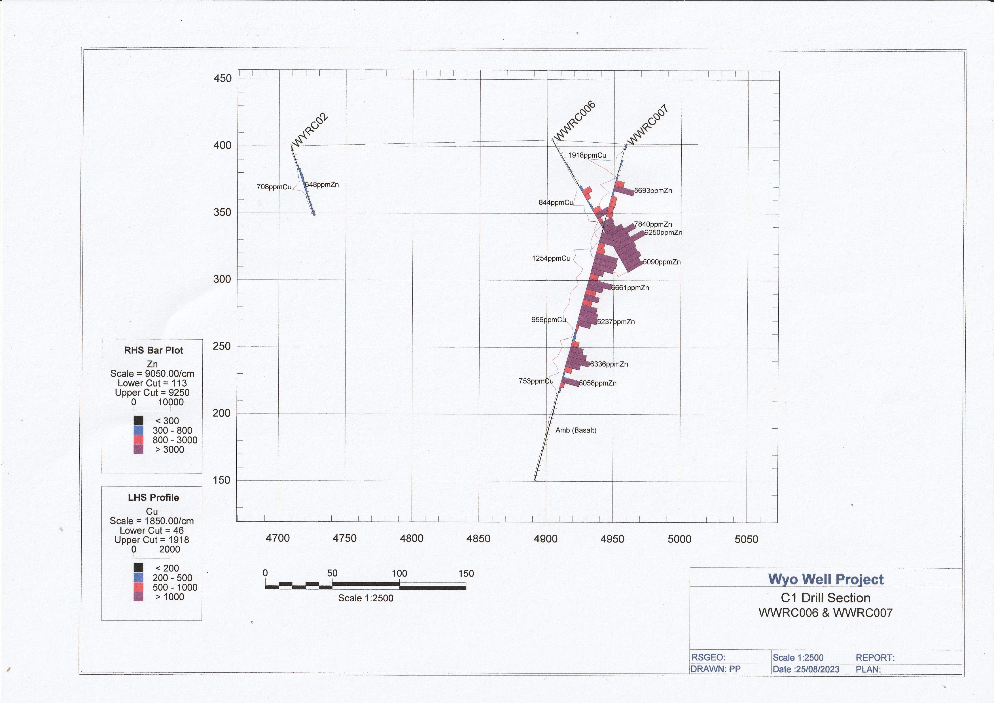
Wyo Well Project Kurnalpi WA
In 2022 WWRC007 was drilled to a depth of 260m with anomalous Cu-Zn mineralisation at shallow depth from 28m -56m peaking at 0.57%Zn from 32 – 36m
From 68m anomalous mineralisation with elevated Cu-Zn to 140m with an intersection of 0.6%Zn 0.12%Cu from 84 – 96m.
From 152m similar elevated grades continued in a carbonaceous shale to the basalt contact at 188m
TGC analysis was carried out to quantify the graphite/carbon content of the carbonaceous shale.
Notes:
Figure 4
In 2022 exploration work included drilling a reverse circulation drill hole WWRC007 to a depth of 260 metres and an investigation was carried out to quantify the graphite/carbon content of the carbonaceous shale intersected. Low grade zinc mineralization appeared to be prominent on the upper amphibolite contact peaking at 0.57%Zn from 32m – 36 and 0.17%Zn from 44m - 48m. From 68m, zinc mineralization in the carbonaceous shale was of a low tenor but with elevated grades to 140m. At 140m the sedimentary unit was in contact with basalt with zinc mineralization peaking at 0.52%Zn and at 156m, zinc mineralization continued in a carbonaceous shale to 192m where the contact zone with basalt continues to the end of hole at 260m.

Slide 11
Wyo Well Project Kurnalpi WA
An analysis of the graphite content in the graphitic carbonaceous shale in WWRC007 was conducted in 2022.
Fifty 4m pulp samples (WWC110 –WWC159) indicated in an elevated and anomalous zone from 84m - 136m with peak results of:
7.7%C, 0.61%Zn, 0.12%Cu 84m – 88m.
8.1%C, 0.63%Zn. 0.11%Cu 88m – 92m.
7.1%C, 0.45%Zn 0.05%Cu 108m – 112m.
8.2%C, 0.26%Zn, 0.09%Cu 120m – 124m
75.%C, 0.44%Zn, 0.08%Cu 124m – 128m
Notes:
International Graphite Limited (ASX: IG6) were contacted in 2022 in regard to the carbon content present in the carbonaceous shale in drill hole WWRC007. Testing of the carbon content in fifty 4m pulp samples (WWC110 – WWC159) indicated peak results of:
84m–88m 7.7%C, 0.61%Zn
88m–92m 8.1%C, 0.63%Zn
108m–112m 7.1%C, 0.45%Zn
124m–128m 7.5%C, 0.44%Zn

Slide 12
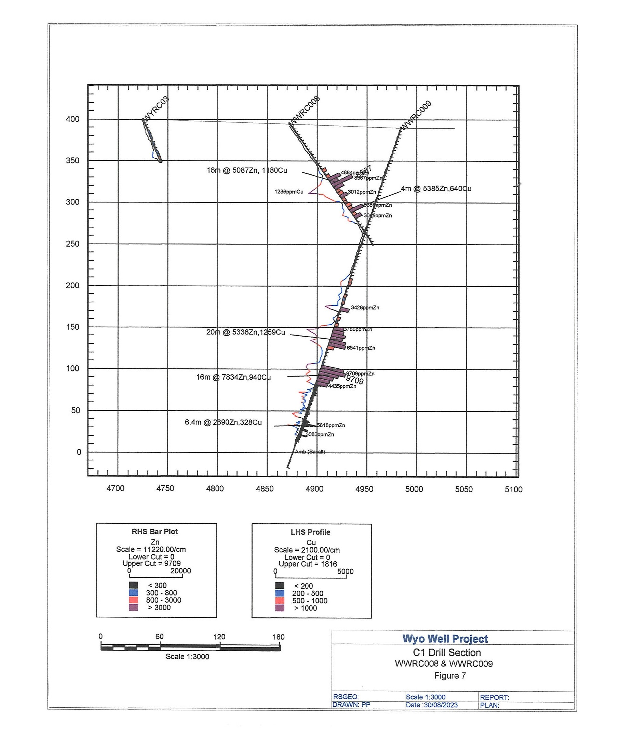
Wyo Well Project Kurnalpi WA
In 2023 drill holes WWRC008 & WWRC009 were designed to intersect the northern edge of the vertical EM anomaly plate WW-C1.
Modelling indicated that the northern edge of the plate was the edge of the pyrrhotite-pyrite core where rich zones of Cu-Zn mineralisation occur.
Peak results included:
WWRC008 – 4m@5385ppmZn, 640ppmCu
WWRC009 – 20m 5336ppmZn, 1259ppmCu;
16m – 7834ppmZn, 940ppmCu
Notes:
Exploration during 2023 included drill holes WWRC008 and WWRC009 (Refer: Figure 7) which were designed to intersect the northern edge of the vertical WW_C1 EM anomaly plate, assumed to be at the edge of the pyrrhotite-pyrite core of mineralization where in theory mineralized zones of zinc rich mineralization were thought to

Slide 13
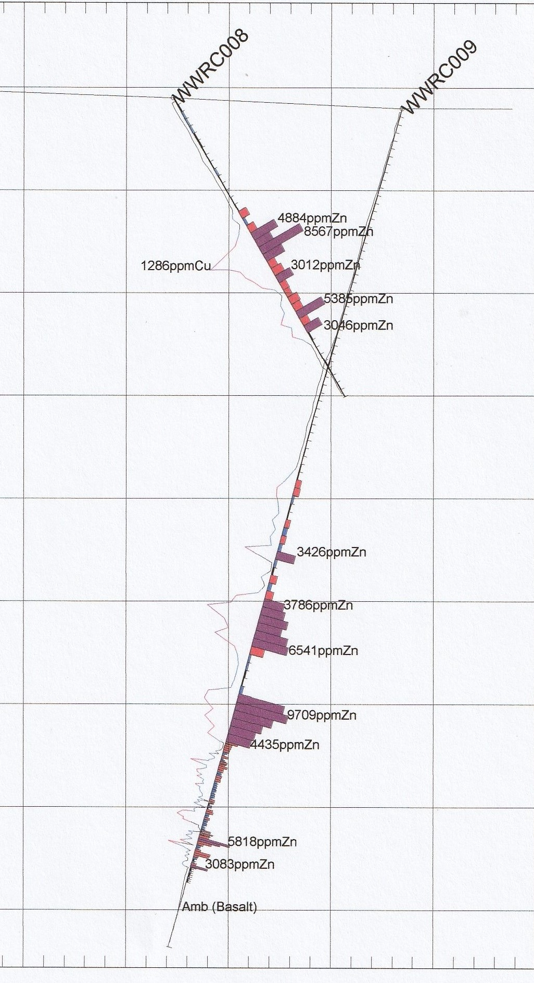
Wyo Well Project Kurnalpi WA
In WWRC009 a basalt – carbonaceous shale sequence identified from the surface continuing to a depth of 188m.
From 188m magnetite and sulphides indicated the beginning of the mafic - sedimentary sequence included a main carbonaceous shale –basalt-carbonaceous shale from 248m to the end of the percussion hole at 320.8m.
At 320.8m a 4.3m intersection of massive sulphides was identified in the diamond tail mainly pyrite-pyrrhotite with minor sphalerite.
From the massive sulphide a strong magnetic altered sediment and inlier mafic flows continued to the basalt contact at 383.38m.
The diamond tail of WWRC009 ended in a basalt at 423.8m.
Notes:
In drill hole WWRC009 rock chip samples were collected in chip trays from a depth of 200m to a depth of 320m. The mafic basalt–carbonaceous shale sequence was identified at different 1m intervals from the surface and checked against 4m assay values. A weathered carbonaceous shale complex was apparent from 0m – 22m followed by a mafic sequence continuing to a depth of 188m. .

